Slide 1


Miguel Valentín-Gamazo Pontijas
1st-Jul-2023

Slide 2

Outline
Executive Summary
Introduction
Methodology
Results
Conclusion
Appendix

Slide 3
Executive Summary
Summary of methodologies
Collecting the data (API and Webscraping)
Data Wrangling
EDA with SQL
EDA with Pandas+Matplotlib
Interactive map with Folium
Interactive dashboard with Ploty Dash
Predictive analysis with machine learning
Summary of all results
EDA results
Interactive analysis
Predictive analysis

Slide 4
Introduction
Project background and context
SpaceX is a successful player in commercial space travel. One reason behind this success is the relatively inexpensive cost of rocket launch thanks to the reusability of the first stage -the most expensive part of a rocket launcher-.
Problems you want to find answers
In this project, our job will be to determine the price of each launch which depends on whether the first stage would land successfully to be reused.

Slide 5

Section 1

Slide 6
Methodology
Executive Summary
Data collection methodology:
Space X rest API
Webscraping from Wikipedia using BeautifulSoup and Requests
Perform data wrangling
Data were analyzed and new landing classes created using Pandas and Numpy
Perform exploratory data analysis (EDA) using visualization and SQL
Perform interactive visual analytics using Folium and Plotly Dash
Perform predictive analysis using classification models
LR, KNN, SVM and DT models were created splitting the dataset into test and training

Slide 7
Data Collection
First some data were extracted from the API rest of SpaceX using get Requests. Then received data were transformed from JSON into a csv
A second set of data was downloaded from Wikipedia using Requests and BeautifulSoup. The result was a beautiful soup with html code, from which a table was extracted and converted into csv
Consolidated data
CSV
JSON
SpaceX API rest
CSV
BeautifulSoup
Wikipedia

Slide 8
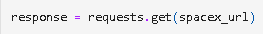
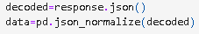
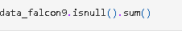
Data Collection – SpaceX API
1 Get request
Get Request
Decode and normalize JSON code
Apply customized functions
Convert into dictionary and data frame
Data cleaning (missing values)
Export to csv
https://github.com/Zdarec56/Applied-Data-Science-Capstone-Coursera-IBM/blob/main/jupyter-labs-spacex-data-collection-api.ipynb
2 JSON decode
3 Apply customized functions
4 Convert into data frame
5 Cleaning and missing values
6 Export to CSV

Slide 9
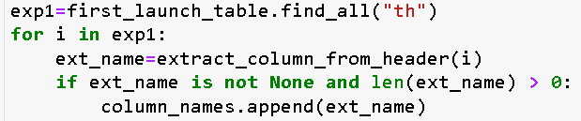
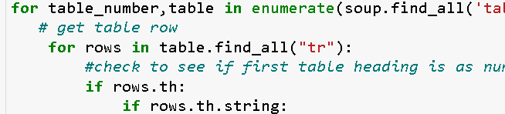
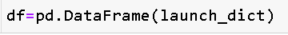
Data Collection - Scraping
1 Get request
Bscraping from wikipedia "List of Falcon 9 and Falcon Heavy launches"
https://github.com/Zdarec56/Applied-Data-Science-Capstone-Coursera-IBM/blob/main/jupyter-labs-webscraping2.ipynb
2 Create a BS object
3 Find the table wanted
4 Get column names
5 Create a dictionary
6 Append data to each key
(see the Jupyter notebook for this)
7 convert to dataframe
8 create a csv

Slide 10
Data Wrangling
check missing values
column data types in the df
calculate the launches per site
count the occurrence of each orbit
calculate the outcome per orbit type
label the landing outcomes (0=fail, 1 success)
export to csv
calculate the success rate
https://github.com/Zdarec56/Applied-Data-Science-Capstone-Coursera-IBM/blob/main/labs-jupyter-spacex-Data%20wrangling.ipynb

Slide 11
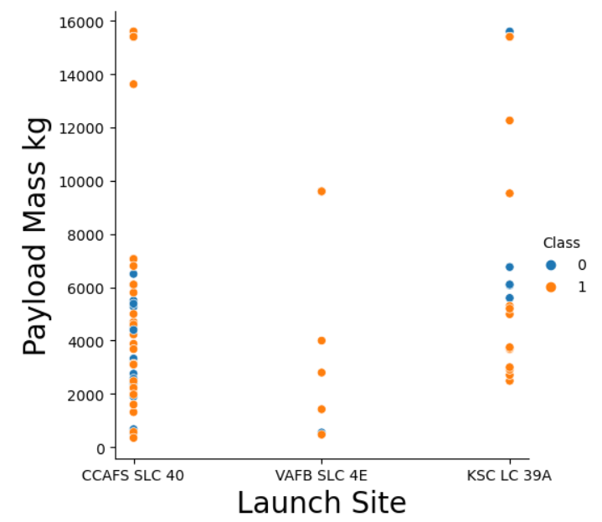
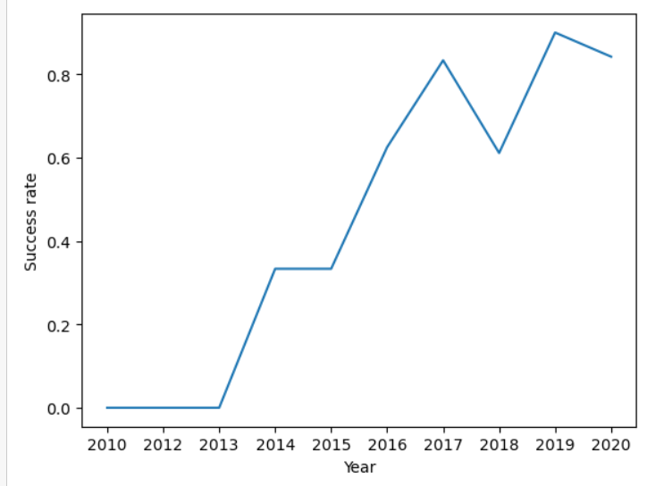
EDA with Data Visualization
Relationship btw. flight number and launch site (by class): how often was each site used and whether at the end or at the beginning
2. Launchsite vs. Payload mass. From where were the heavy payloads launched (not from the second site)
3. Orbit and class. To show which orbits had higher success rate
4. Flight number and orbit. Which orbits were used at the beginning and which were used more often and success patterns
5. Payload and orbit. Which orbits are used for heavy or light payloads
6. Year and success rate. The success rate improves with time (tendence)
https://github.com/Zdarec56/Applied-Data-Science-Capstone-Coursera-IBM/blob/main/IBM-DS0321EN-SkillsNetwork_labs_module_2_jupyter-labs-eda-dataviz.ipynb.jupyterlite.ipynb

Slide 12
EDA with SQL
Display names of unique launch sites
Display records that start with CCA
Total payload mass by boosters launched by NASA
Average payload mass carried by boosters F9 v. 1.1
Date of first successful landing outcome
Name of boosters with success (drone ship) and mass btw. 4000-6000
Total number of successful and failure mission outcomes
Name of the booster_versions that have carried the maximum payload mass
List of records which month number + "failure (drone ship)" + booster version + launch_site for year 2015
Count of successful landings between 04-06-2010 and 20-03-2017
https://github.com/Zdarec56/Applied-Data-Science-Capstone-Coursera-IBM/blob/main/jupyter-labs-eda-sql-coursera_sqllite_FINAL.ipynb

Slide 13
Build an Interactive Map with Folium
Different objects were created to the maps:
Circles and label names: to show launch sites
Marker clusters (green and red): summarize all successful and failed launches
Mouse position: to show the latitude and longitude of pointer
Polylines: to measure distances between launch site and roads, coast...
https://github.com/Zdarec56/Applied-Data-Science-Capstone-Coursera-IBM/blob/main/IBM-DS0321EN-SkillsNetwork_labs_module_3_lab_jupyter_launch_site_location.jupyterlite.ipynb

Slide 14
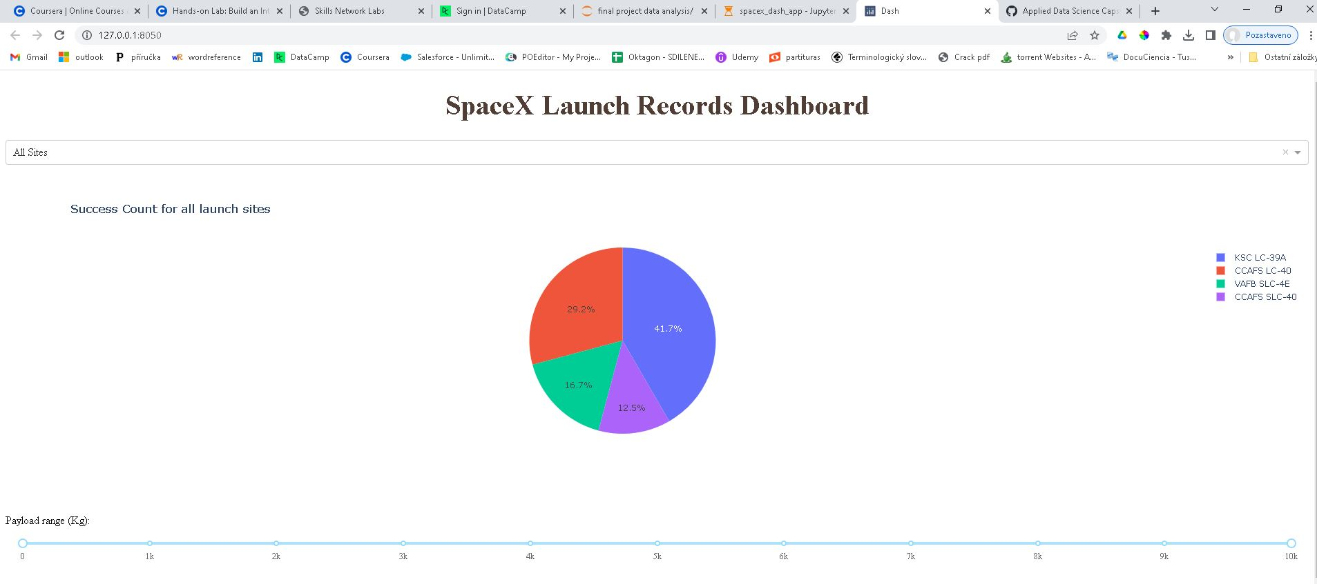
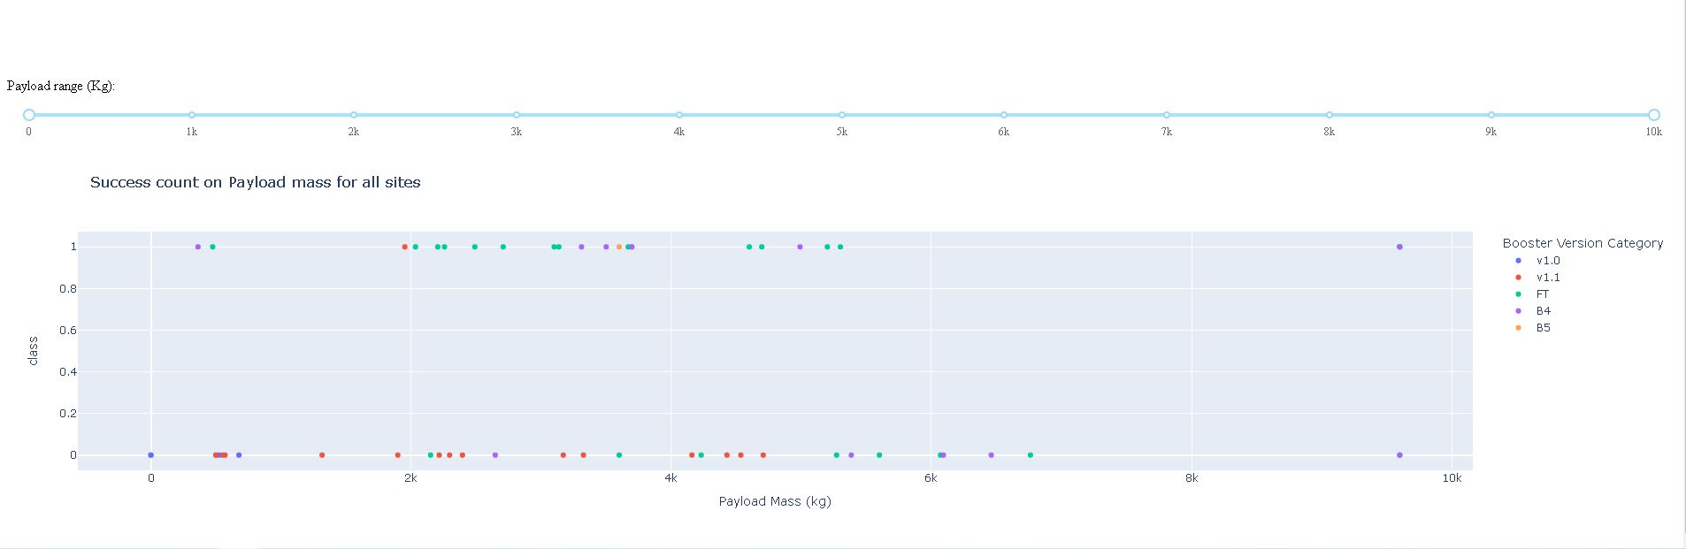
Build a Dashboard with Plotly Dash
Dropdown menu to select the launch site
Pie chart to show successful launches per site
Pie chart to show success vs. failure of a specific site
Slider to select payload range
Scatter plot: correlation btw. Payload and launch success
https://github.com/Zdarec56/Applied-Data-Science-Capstone-Coursera-IBM/blob/main/spacex_dash_app.py

Slide 15
Results
Exploratory data analysis results
Not all launch sites were suitable for all payload masses.
The success rate improved with time (highest in the last years)
Average payload mass= 2928.4 kg
Interactive analytics demo in screenshots
Predictive analysis
Decision tree had slightly better accuracy but poorer prediction score
KNN was in general the best. Had the same prediction score than SVM and LogReg, but slightly better accuracy.

Slide 16
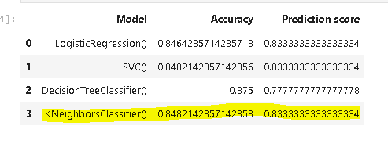
Predictive Analysis (Classification)
Split data
(80% train and 20% test)
For each model accuracy score and confusion matrix
Support Vector Machine
Logistic Regression
Decision Tree
K-Nearest Neighbours
Decision tree: slightly better accuracy but worse prediction score
All the rest same score but KNN a bit better accuracy --> KNN
https://github.com/Zdarec56/Applied-Data-Science-Capstone-Coursera-IBM/blob/main/IBM-DS0321EN-SkillsNetwork_labs_module_4_SpaceX_Machine_Learning_Prediction_Part_5.jupyterlite.ipynb

Slide 17

Section 2

Slide 18
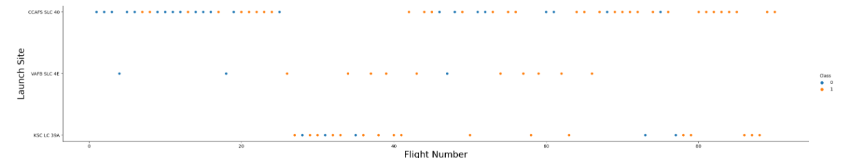
Flight Number vs. Launch Site
At the beginning, almost all launches were sent from CCAFS SLC 40
There is a period in the middle, during which LSC LC 39A substituted CCAFS SLC 40 (possible repair works?)
VAFB SLC 4E was less used than the others

Slide 19
Payload vs. Launch Site
There are almost no launches from site VAFB SLC 4E
From site VAFB SLC 4E there are not launches with payload higher than 10000 kg
Class 1 was more widely used than class 0

Slide 20
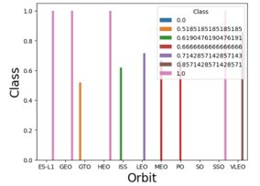
Success Rate vs. Orbit Type
SO the less successful (but only 1 launch see next slide)
GTO and ISS were the next less successful orbits
ES-L1, GEO, HEO and SSO the most successful

Slide 21
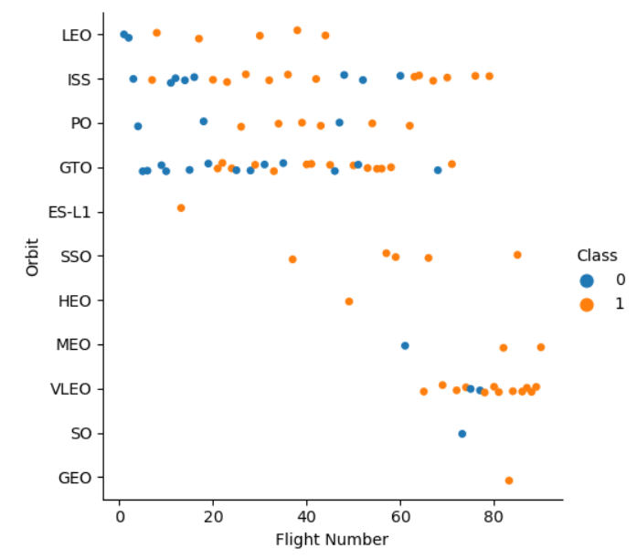
Flight Number vs. Orbit Type
SSO had 5 out of 5 successful launches
ES-L1, GEO, HEO, also 100% successful but only 1 launch
LEO only fails at the beginning.
No clear pattern for GTO

Slide 22
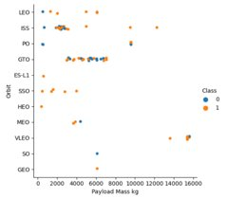
Payload vs. Orbit Type
No clear pattern for GTO
In LEO and ISS an increase of payload seems to increase the success
SSO only low payloads but all successful

Slide 23
Launch Success Yearly Trend
The success rate seems to increase by time. That is due to the cumulated knowledge/experience).

Slide 24
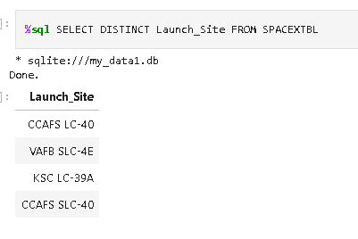
All Launch Site Names
Find the names of the unique launch sites
%sql : to indicate that the line is not Python but SQL
SELECT: the start of most SQL requests
DISTINCT Launch_Site: from the column Launch Site we want to select only unique names (no repeat)
FROM SPACEXTBL: the table from which data are retrieved is called SPACEXTBL

Slide 25
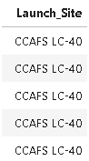
Launch Site Names Begin with 'CCA'
Find 5 records where launch sites begin with `CCA`
%sql SELECT Launch_Site FROM SPACEXTBL WHERE Launch_Site LIKE 'CCA%' LIMIT 5
WHERE Launch_Site LIKE 'CCA%': restricts the search to elements that start by CCA.
LIMIT 5: restricts the search to the first 5 elements

Slide 26
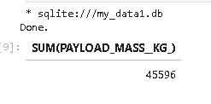
Total Payload Mass
Calculate the total payload carried by boosters from NASA
%sql SELECT SUM(PAYLOAD_MASS__KG_) FROM SPACEXTBL WHERE Customer='NASA (CRS)'
SUM(PAYLOAD_MASS__KG_): sums all values from that column
WHERE Customer='NASA (CRS)': restricts the selection only to lines where the customer is NASA

Slide 27
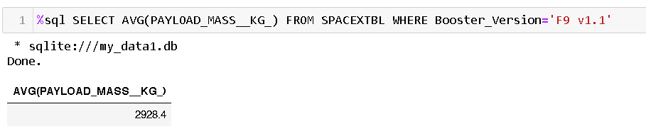
Average Payload Mass by F9 v1.1
The clause WHERE is to restrict the selection. The name of the booster shall be between simple quotation marks '___'

Slide 28
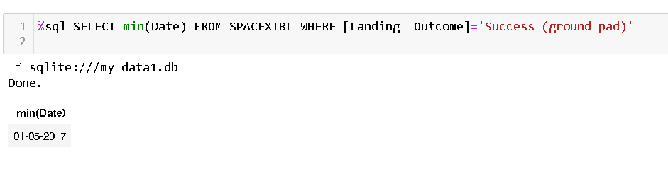
First Successful Ground Landing Date
The first successful landing date

Slide 29
Successful Drone Ship Landing with Payload between 4000 and 6000
Names of the boosters:
F9 FT B1022
F9 FT B1026
F9 FT B1021.2
F9 FT B1031.2
WHERE --> to insert conditions. In this case, there are two conditions (successful landing + payload btw 4k and 6k); therefore, we use AND to ensure both conditions are fulfilled.
%sql SELECT Booster_Version FROM SPACEXTBL WHERE [Landing _Outcome]='Success (drone ship)' AND PAYLOAD_MASS__KG_ BETWEEN 4000 and 6000

Slide 30
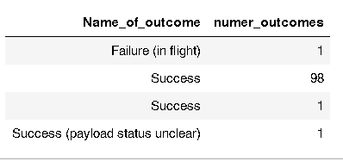
Total Number of Successful and Failure Mission Outcomes
%sql SELECT MISSION_OUTCOME AS Name_of_outcome, COUNT(MISSION_OUTCOME) AS numer_outcomes FROM SPACEXTBL GROUP BY MISSION_OUTCOME;
There are 100 sucessful mission outcomes vs. only 1 failure

Slide 31
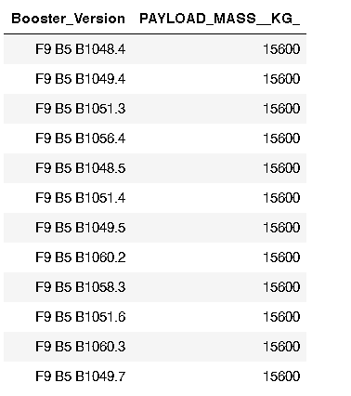
Boosters Carried Maximum Payload
%sql SELECT BOOSTER_VERSION,PAYLOAD_MASS__KG_ FROM SPACEXTBL WHERE PAYLOAD_MASS__KG_ = (SELECT MAX(PAYLOAD_MASS__KG_) FROM SPACEXTBL)
There is a nested subquery in the clause where, to select those launches with maximum payload mass

Slide 32
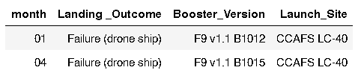
2015 Launch Records
%sql SELECT substr(Date, 4, 2) AS month, [LANDING_OUTCOME], BOOSTER_VERSION, LAUNCH_SITE FROM SPACEXTBL WHERE [LANDING_OUTCOME]='Failure (drone ship)' AND substr(Date,7,4)='2015'
In this case, the failed ones are required.
SQLLite does not support month names. So instead we use substr(Date, 4, 2) as month and substr(Date,7,4)='2015' for year.

Slide 33
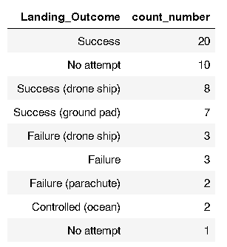
Rank Landing Outcomes Between 2010-06-04 and 2017-03-20
%sql SELECT LANDING_OUTCOME, COUNT([LANDING_OUTCOME]) AS count_number FROM SPACEXTBL WHERE Date BETWEEN '04-06-2010' AND '20-03-2017' GROUP BY Landing_Outcome ORDER BY count_number DESC
Success and No attempt are the most common landing outcomes.

Slide 34

Section 3

Slide 35
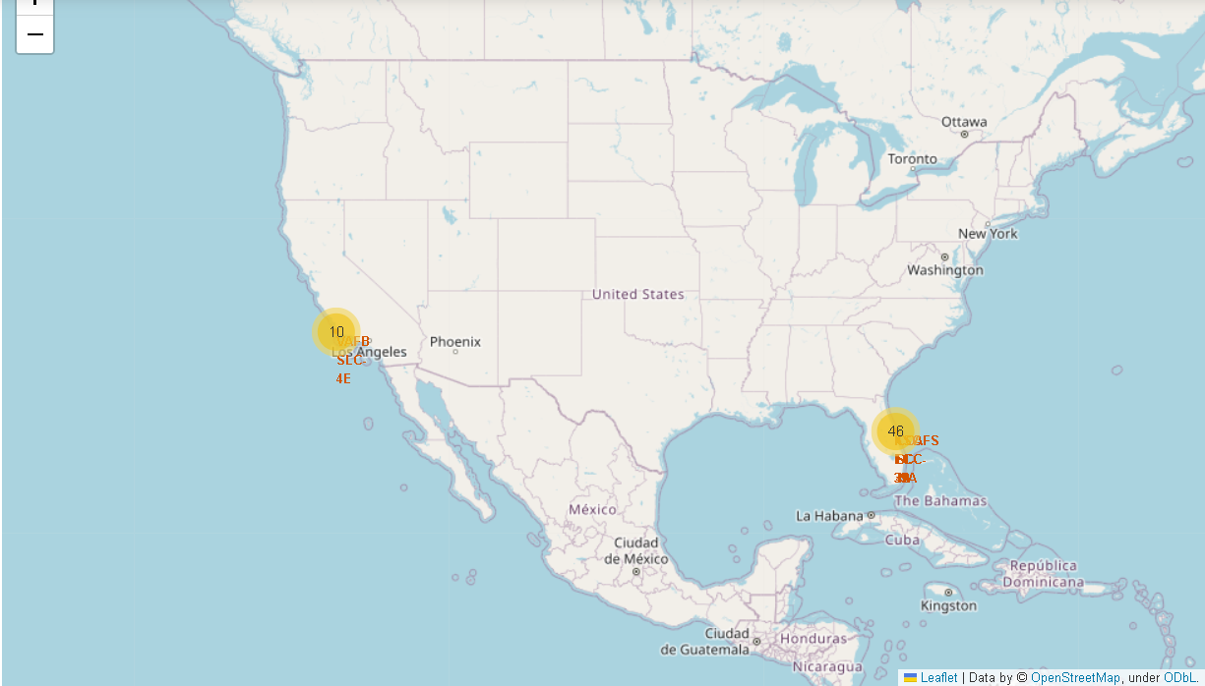
Map of all launch sites
There are 56 Launch sites, 46 in the East coast (Cape Canaveral) and 10 by the West coast.

Slide 36
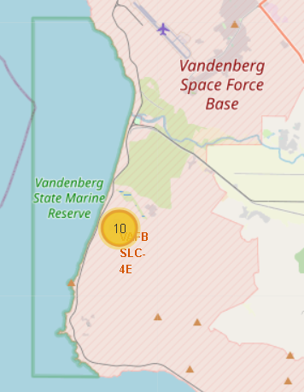
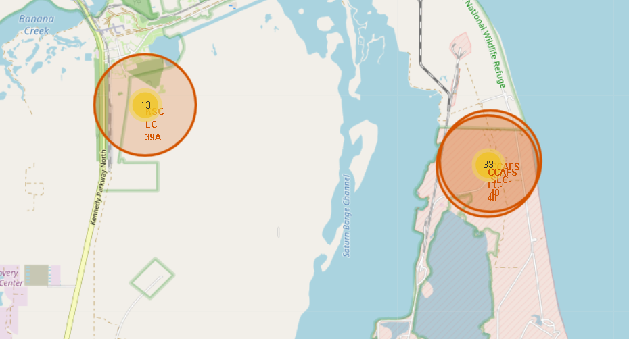
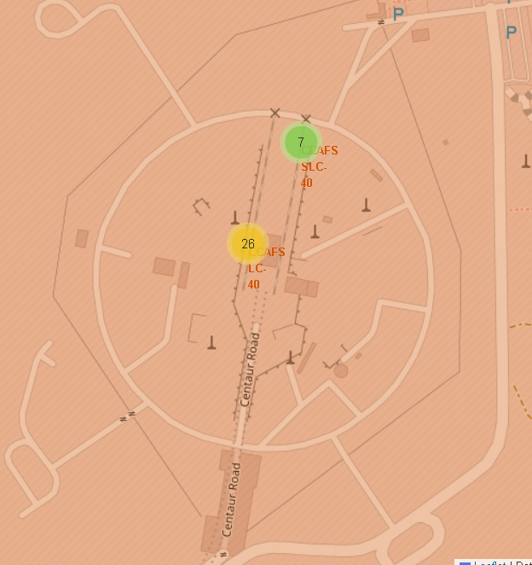
Success/failed launches for each site
Only one site shows failed AND successful launches (CCAFS-LC-40)

Slide 37
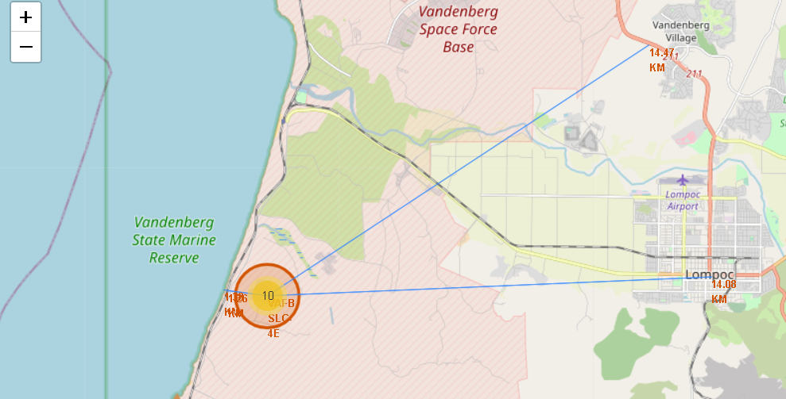
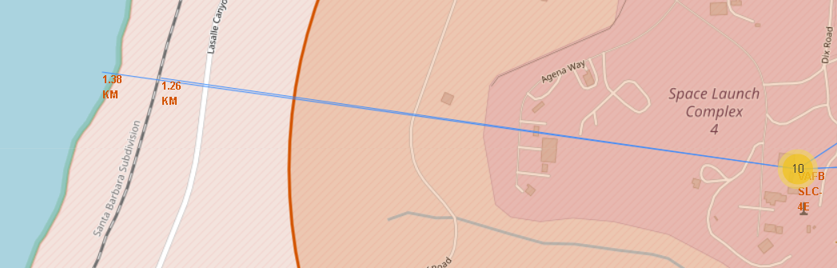
Launch site: distance to infrastructures
Launch sites are close to the coast, railways and highways, as shown here:
1.26 km to railway,
1.38 km to the coast,
14.08 km to a city (Lompoc) btw. with an airport
14,47 km to a highway

Slide 38

Section 4

Slide 39
Total successful launches (by all sites)
Most successful launches are from the site KSC LC-39A (41,7%)

Slide 40
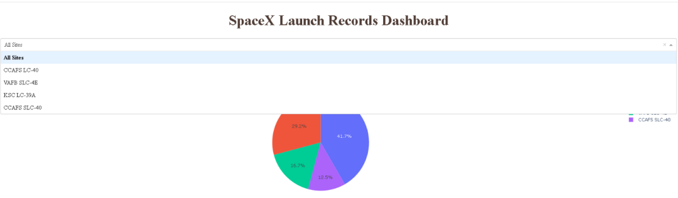
Piechart for each site
Using the selectable menu it is possible to generate a pie chart for any specific launch site

Slide 41
Payload vs Launch outcome
Success rate is higher for payloads between 2k and 4k

Slide 42

Section 5

Slide 43
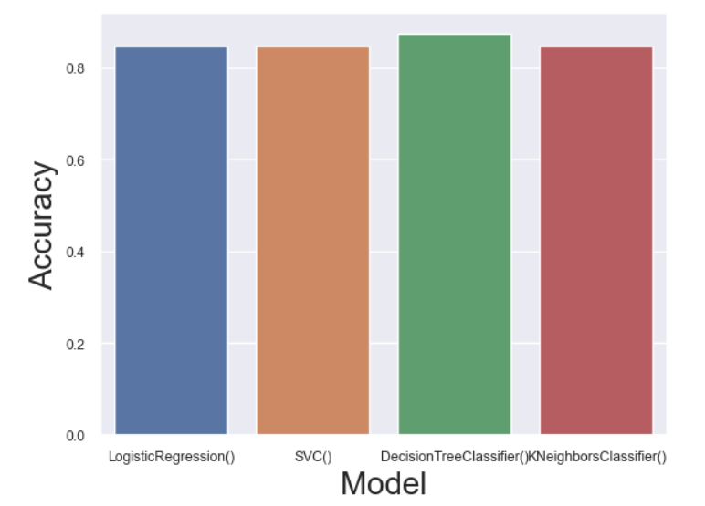
Classification Accuracy
Decission Tree provides the highest classification accuracy

Slide 44
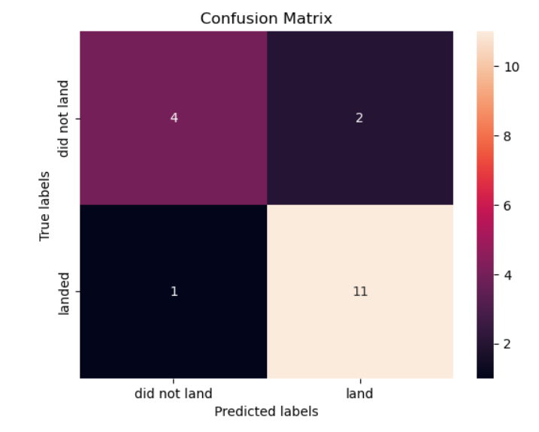
Confusion Matrix
Dedcision tree model has the best accuracy. Also we see that it is good distinguishing between the different classes. We see that the error is distributed both in false possitives (2) and false negatives (1).

Slide 45
Conclusions
ES-L1, GEO, HEO and SSO the most successful orbits
In orbits LEO and ISS an increase of payload seems to increase the success
The success rate of launches seems to increase by time. That is due to the cumulated knowledge/experience).
The first successful landing date was the 01-05-2017
There are 100 successful mission outcomes vs. only 1 failure
Most successful launches are from the site KSC LC-39A (41,7%)
All four ML models provide similar results. Decision Tree provides the highest classification accuracy

Slide 46
Appendix
Python code to create the barchart on the slide 43
sns.set(font_scale=0.8) #to reduce the font scale so that the labels do not overlap
results_df['Accuracy'] = pd.to_numeric(results_df['Accuracy'])
results_df['Prediction score'] = pd.to_numeric(results_df['Prediction score'])
sns.barplot(x="Model",y="Accuracy",data=results_df)
plt.xlabel("Model",fontsize=20)
plt.ylabel("Accuracy",fontsize=20)
plt.show()

Slide 47


